Slide 1
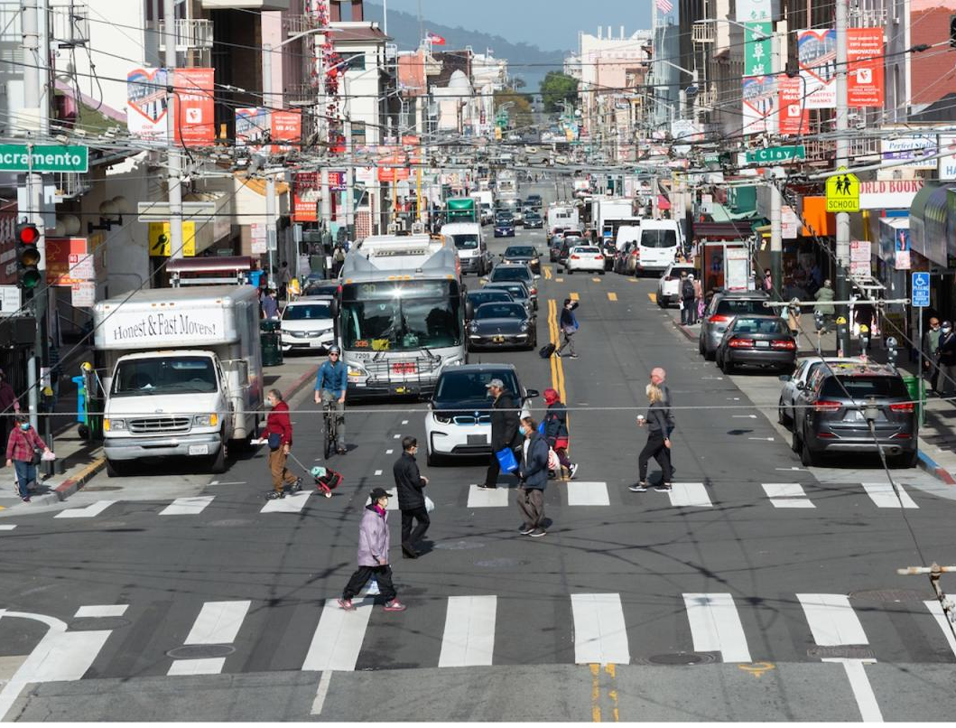


Adversarial Patch Attacks for the Camouflaging of Pedestrians and Cars From Computer Vision Models in Autonomous Driving
Kevin Lizarazu-Ampuero
Jhonny Velasquez
December 3, 2022 Computer Vision 4554
Notes:
How object detectors are affected by adversarial attacks, specifically patch attacks

Slide 2
Motivation
Machine Learning based object detectors are rapidly becoming adopted by many different industries
Their performance is often relied heavily upon for making critical decisions
Autonomous Driving
Security Systems
It is important that these tools are robust to adversarial attacks
01
/
Design Overview
Notes:
Machine learning and deep learning algorithms are all around us in this modern age, automating a lot of the tasks that are either too repetitive or demanding
To achieve desirable levels of automation that is both accurate and inexpensive is difficult to achieve with the circumstances of adverse weathter, lighting conditions, accluded objects, and even adversaries that make it their mission to break these systems.

Slide 3
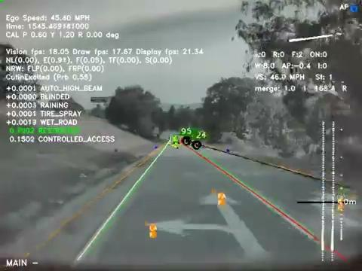
Object Detection Demo
Object Detection for Autonomous Driving
https://www.tesla.com/AI
02
/
Design Overview

Slide 4
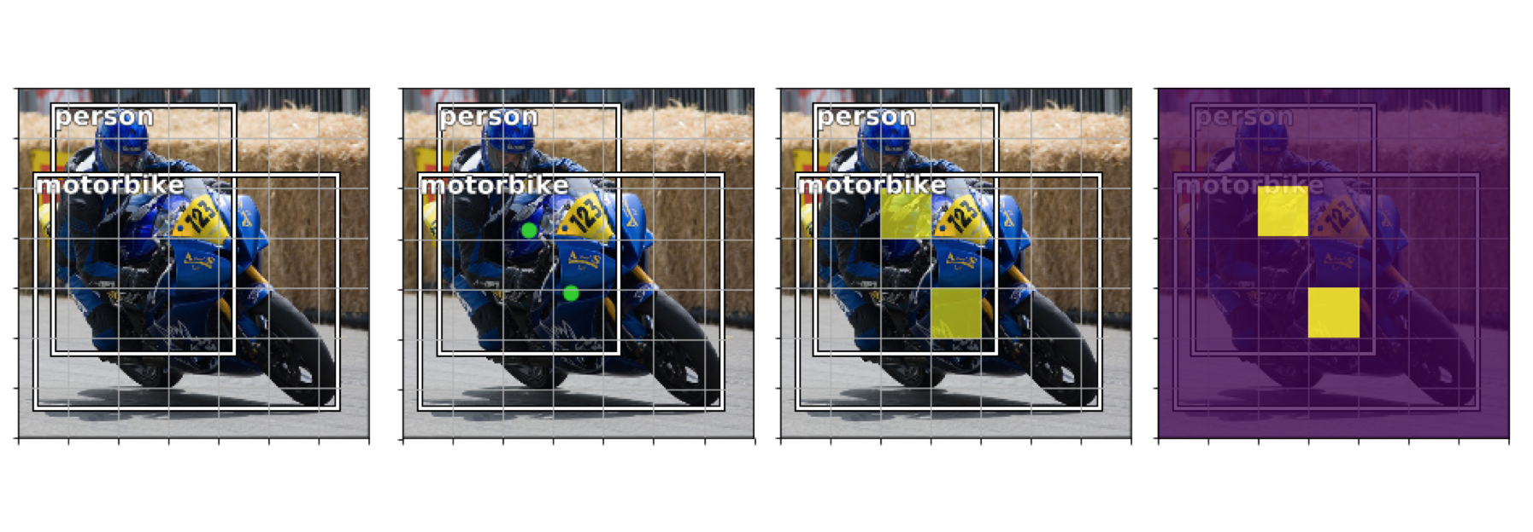
Object Detector - Under the Hood
An overview of object detection: one-stage methods.
Training
Collection of a dataset representative of your targets to detect
Evaluation
Comparison of training vs validation loss (i.e. over/underfitting)
Deployment of model in real world environments
Architecture
Convolutional backbone as the feature extractor
Sliding window style prediction which then uses a mixed regression and classification objective to achieve the goal of detecting objects
03
/
Design Overview

Slide 5
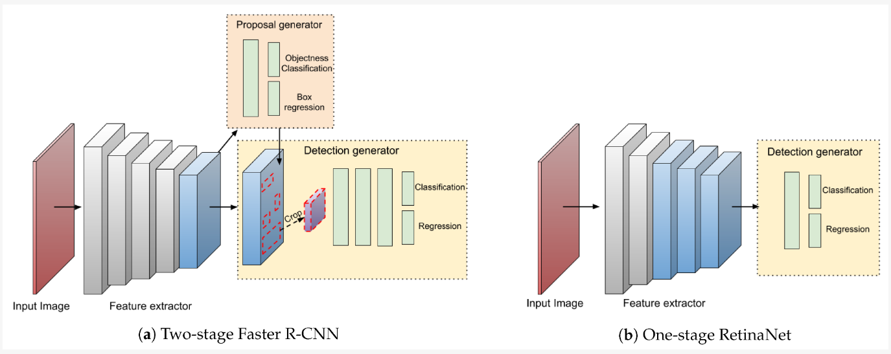
Object Detectors - Frameworks
Single Stage Detectors
Inferences and object proposal are generated at once
YOLO, SSD, RetinaNet
Lower accuracy, fast output
Two Stage Detectors
Region Proposal Network and inference generation are separate
R-CNN, Faster R-CNN, FPN
Slower, more accuracy
On the Performance of One-Stage and Two-Stage Object Detectors in Autonomous Vehicles Using Camera Data
04
/
Design Overview
Notes:
To increase opportunity of fooling object detector we the single stage detection framework will be chosen

Slide 6
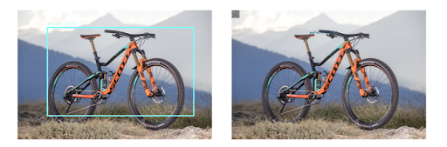

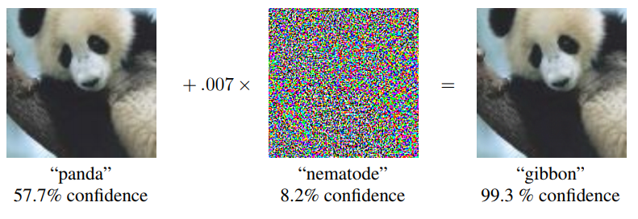
Adversarial Attacks
Black and white box attacks
Expectation over Transformation
Targeted vs Untargeted
DPatch: An Adversarial Patch Attack on Object Detectors
Adversarial Patch
Adversarial Attacks and Defences for Convolutional Neural Networks
05
/
Design Overview
Notes:
Black Box Attack - crafted on a surrogate model where the user doesn’t know the weights and framework, more realistic to the real world
White Box Attack - user knows the weights and framework of the object detection model to train an adversarial patch
Obtain bounding box information,
updates pixels in patch to minimize objectness score in the output feature map
Additional transformations and augmentations, as per the EoT function
Targeted - makes occupied bounding box region as the only Region of Interest and invalidate all others
Untargeted - aims to disable the detector and misclassify objects

Slide 7


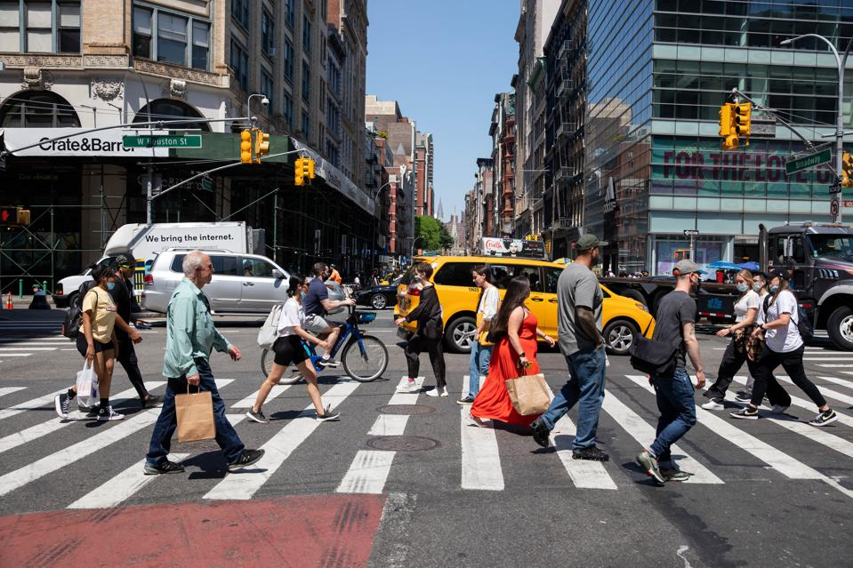
Problem Statement
Given the importance of object detectors in critical applications, it is important that techniques are developed to protect these systems from malicious actors which could cause the model to make incorrect inferences
This project will evaluate to what extent DPatch, a particular adversarial attack, works to mislead object detectors
06
/
Design Overview
Notes:
In summary this project will go deeper into how adversarial attacks from malicious actors play a role in the security of those that depend on these systems.

Slide 8
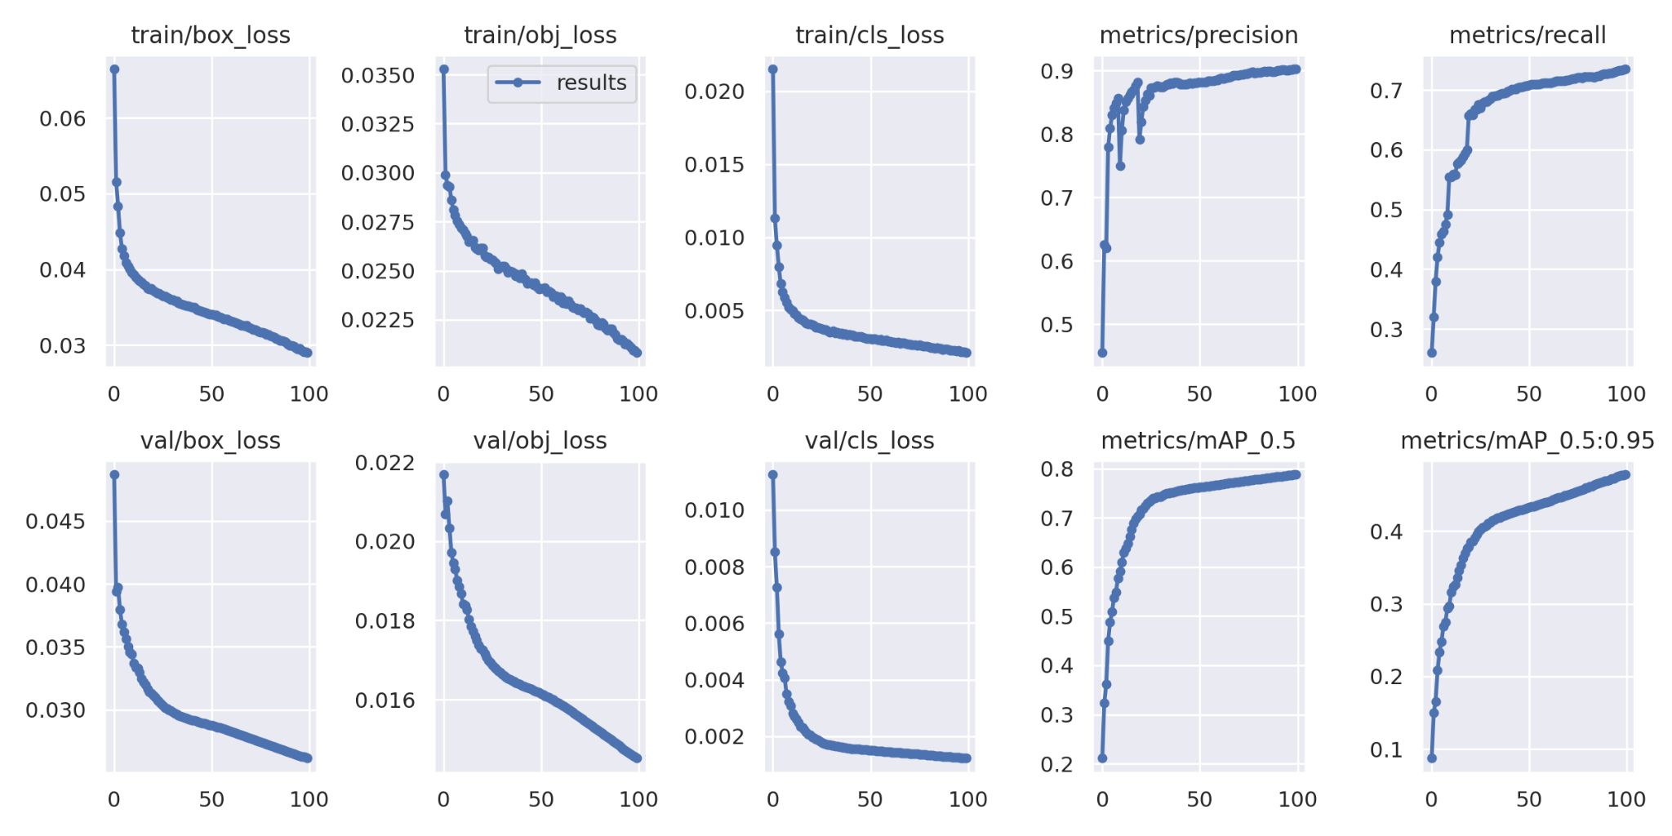
Object Detector Graphs
07
/
Design Overview
Notes:
To increase opportunity of fooling object detector we the single stage detection framework will be chosen

Slide 9
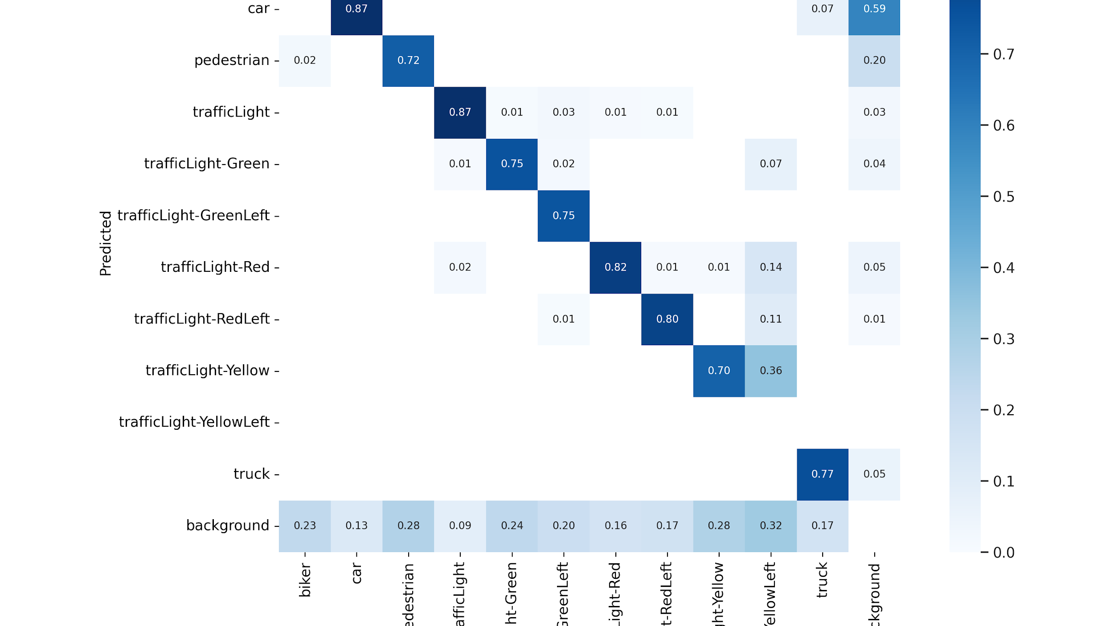

Slide 10
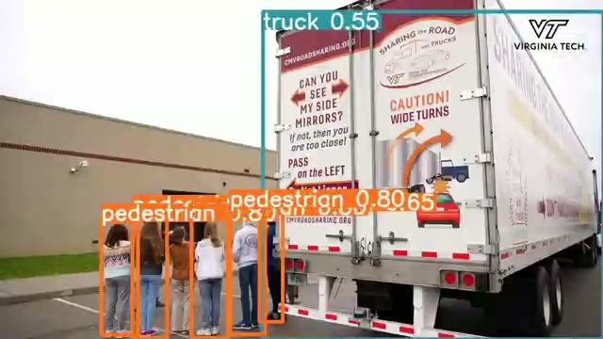
Object Detector Result Teaser
Have any questions/want to find more,
contact lizarazukevin@vt.edu or jhonnyv19@vt.edu for ongoing development
07
/
Design Overview
Notes:
To increase opportunity of fooling object detector we the single stage detection framework will be chosen

